Slide 1
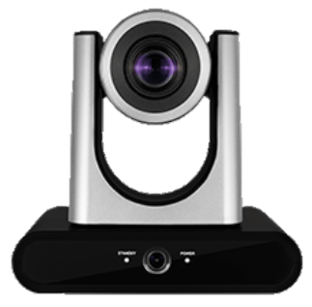
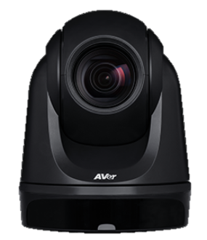
VC-TR40 vs. Aver DL30
Lumens VC-TR40
Aver DL30

Slide 2
Lumens Strength

Slide 3
VC-TR40 vs DL30
Comparison Chart
Lumens VC-TR40
Aver DL30
MSRP Price(USD) | $1,899 | $999
Tracking Type | Dual Lens | Single Len
Video Output Interface | 3G-SDI, HDMI, Ethernet, USB 3.0 | Ethernet, USB 3.0
Zoom | Optical: 20x / Digital Zoom:8x | Optical: 12x / Digital Zoom:2x
HFoV | 58.7° | 76.5°
Gesture Control | Yes | No
Auto Framing | Yes | No
Panoramic camera | 2MP CMOS, 110° HFoV | No
Pan Speed | 0.2~120°/sec | 1~90°/sec
Tilt Speed | 0.2~80°/sec | 7.85~45°/sec
Smooth Pan/Tilt movement | Yes,0.1°/sec | No
Output Resolution and FPS (All outputs are output simultaneously) | 1080p 60 fps (3G-SDI, HDMI, Ethernet, USB 3.0) | 1080p 30 fps (Ethernet, USB 3.0)
IP Streaming | RTSP，RTMP、RTMPS、SRT | RTSP，RTMP
Warranty | 5 years | 3 years

Slide 4
VC-TR40 vs DL30
Dual Lens vs Single lens
Lumens VC-TR40
Aver DL30
Tracking Type | Dual Lens | Single Lens
When a presenter is moving fast, the design of a single lens tracking camera struggles to keep up and loses track of the presenter.
The design of the “Dual lens” mainly uses the Panoramic lens image as the basis for recognition, which greatly reduces the chance of losing track.
PTZ Lens
PTZ Lens
Panoramic lens

Slide 5
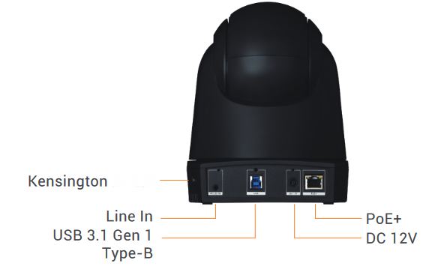
VC-TR40 vs DL30
SDI and HDMI
Lumens VC-TR40
Aver DL30
Video Output Interface | 3G-SDI, HDMI, Ethernet, USB 3.0 | Ethernet, USB 3.0
DL30 offers limited connectivity with only has USB and IP output.
VC-TR40 includes SDI and HDMI output offering more flexibility and convenience to integrate with various recording and broadcasting equipment and displays.
VC-TR40
DL30

Slide 6
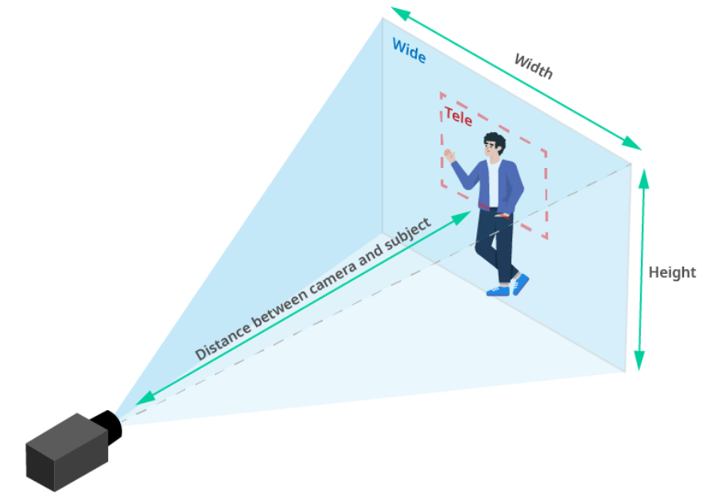
VC-TR40 vs DL30
Optical Zoom 20x vs 12x
Lumens VC-TR40
Aver DL30
Optical Zoom | Optical: 20x / Digital Zoom: 8x | Optical: 12x / Digital Zoom: 2x
The optical zoom determines the installation distance.
VC-TR40 has 20x optical zoom, which allows the camera to be installed at a distance >= 15m.
Ideal K12 / HED solutions from small and medium classrooms to large multipurpose rooms and lecture halls.
DL30 can only be installed within 9m, and additional installation accessories are required. In medium and large classrooms, it may also block the sight of students or spectators on site.

Slide 7
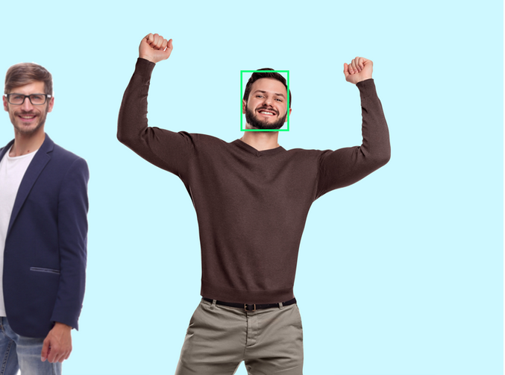
VC-TR40 vs DL30
Gesture Control
Lumens VC-TR40
Aver DL30
Gesture Control | Yes | No
The VC-TR40 features advanced gesture control. When the presenter raises their hands, the tracking target will switch automatically.
VC-TR40 offers the option to manually change the tracked subject by selecting the individual via the web interface.

Slide 8
VC-TR40 vs DL30
Auto & Partition Framing
Lumens VC-TR40
Aver DL30
Auto Framing | Yes | No
Lumens Auto-Framing function allows the VC-TR40 to dynamically adjust, capture, and reframe the view if participants join or leave during the session.
In Partition-Framing mode, the camera will go to a preset position when the presenter enters the area. When the presenter walks out of the area, the camera will go back to the Auto-Framing mode.

Slide 9
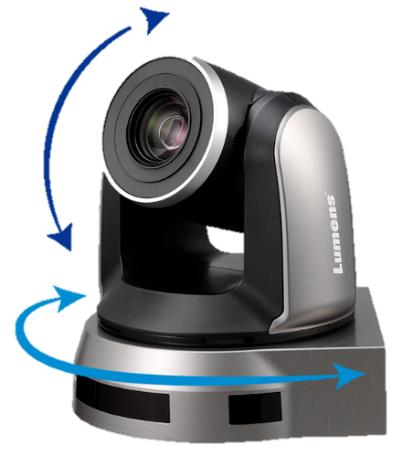
VC-TR40 vs DL30
Pan Tilt Speed
Lumens VC-TR40
Aver DL30
Pan Speed | 0.2~120°/sec | 1~90°/sec
Tilt Speed | 0.2~80°/sec | 7.85~45°/sec
The VC-TR40 maximum speed of Pan and Tilt is faster than that of DL30, which means that it can reach the preset position faster when PTZ is moving.
In addition, the slowest speed of VC-TR40 is slower than that of DL30, which means that VC-TR40 can achieve smoother Pan and Tilt movement.

Slide 10
VC-TR40 vs DL30
Simultaneously Output
1080p 60fps vs 1080p 30fps
Lumens VC-TR40
Aver DL30
Output Resolution and FPS (All outputs are simultaneously active) | 1080p 60 fps (3G-SDI, HDMI, Ethernet, USB 3.0) | 1080p 30 fps (Ethernet, USB 3.0)
Applications such as school stage performances, competitions…etc., need to record smooth dynamic details. Live broadcast video of 30fps no longer meet this demand.
The DL30 can only output 1080p 30fps when using USB and IP streaming at the same time.
All outputs of VC-TR40 can produce 1080p 60fps simultaneously.

Slide 11
VC-TR40 vs DL30
SRT
Lumens VC-TR40
Aver DL30
IP Streaming | RTSP，RTMP、RTMPS、SRT | RTSP，RTMP
VC-TR40 can output SRT, which means that the video can pass through the encrypted SRT and be transmitted to a SRT-compatible platform via the Internet.
For example, if it is sent to Wowza through SRT, it can be broadcast live on the Internet through Wowza server
Through SRT, it can be sent to the production software such as vMix, which can realize the remote broadcast
DL30 does not support SRT, so this feasibility cannot be achieved

Slide 12
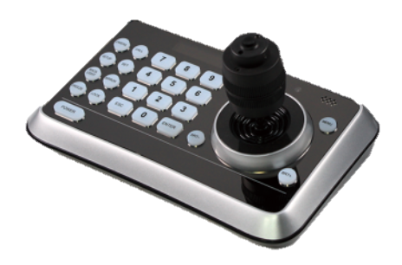
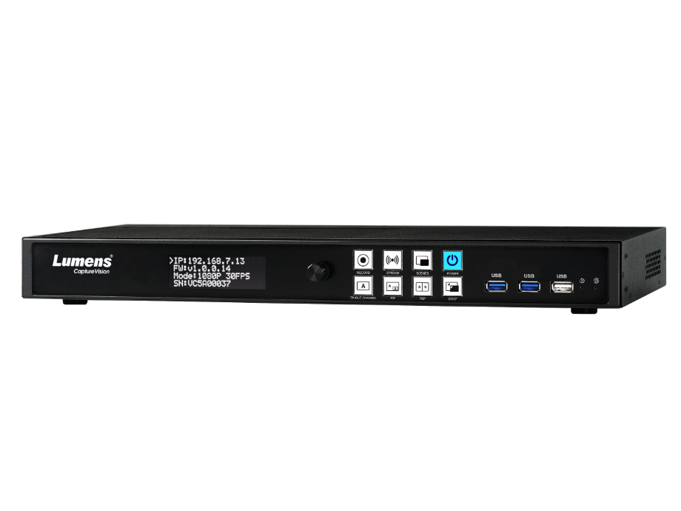
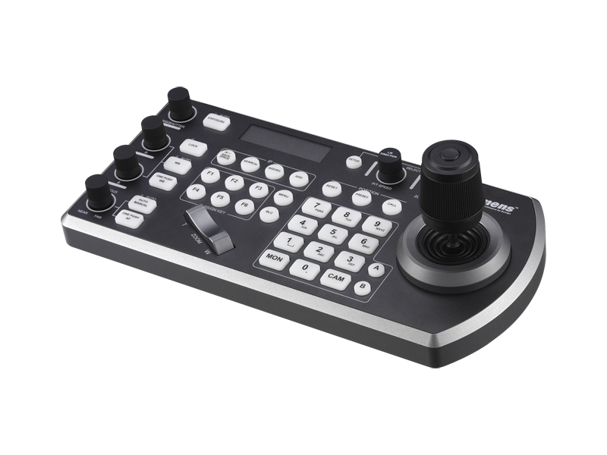
VC-TR40 vs DL30
Integrated Solution
Lumens media processor LC100 can be integrated with Lumens VC-TR40 tracking camera.
Can be integrated with a Crestron control system.
Compatible with Lumens VS-KB30 and VS-KB20 camera controller.
VS-KB20
VC-TR40
LC100
VS-KB30

Slide 13
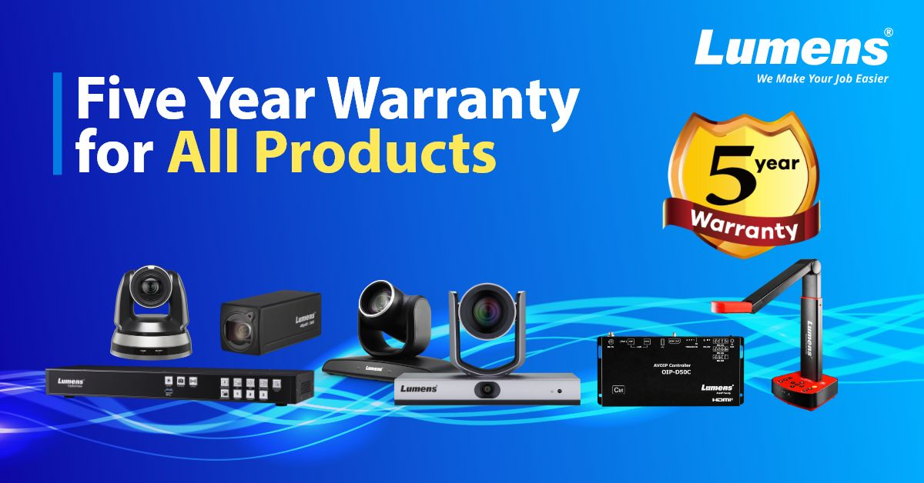
VC-TR40 vs DL30
Warranty
Lumens confidence in the quality of product design allows a 5 year warranty on all products.
Many of our competitors including AVER only offer 3-year warranty. Very risky for those that expect products to last minimum 5 years.
Lumens’ Warranty Service can solve the problems of purchasing department and resellers.

Slide 14
Thank you!

